Slide 1


Slide 2
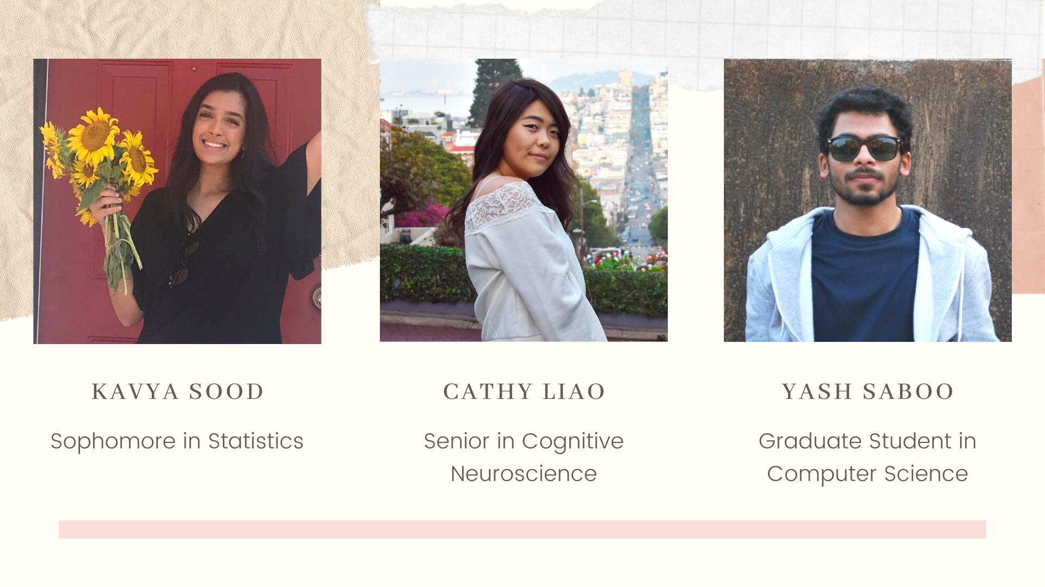
Notes:
all

Slide 3
We have a question.
Notes:
yash

Slide 4
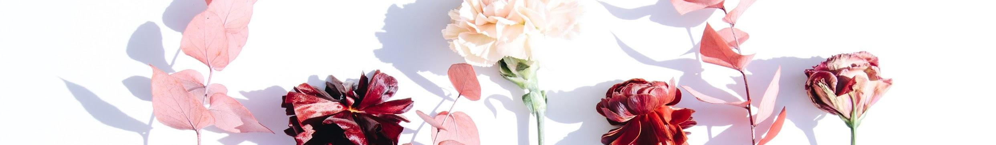
MOTIVATION & METHOD
We were curious about what people who go through periods experience, so we asked them.

Slide 5
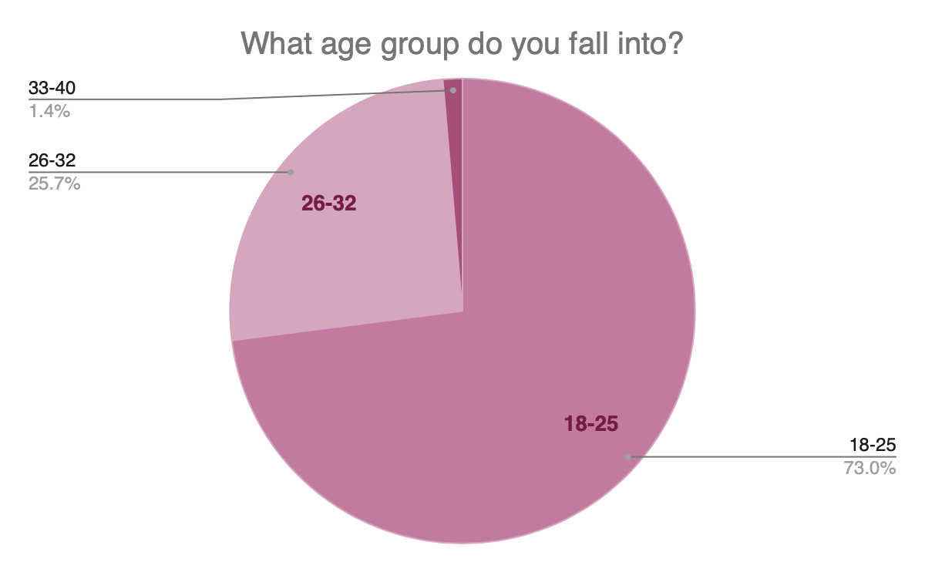
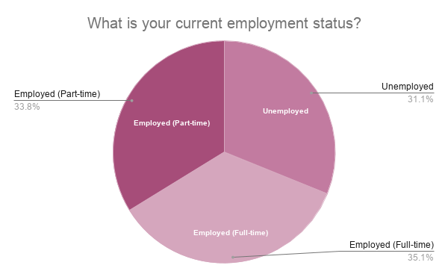
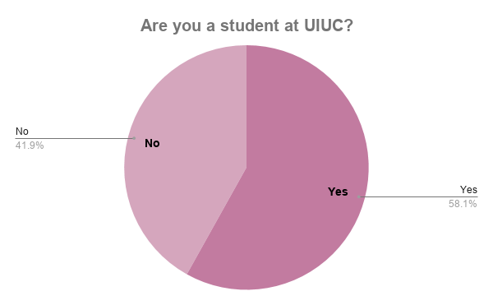
DEMOGRAPHICS
Notes:
kavya

Slide 6


Slide 7
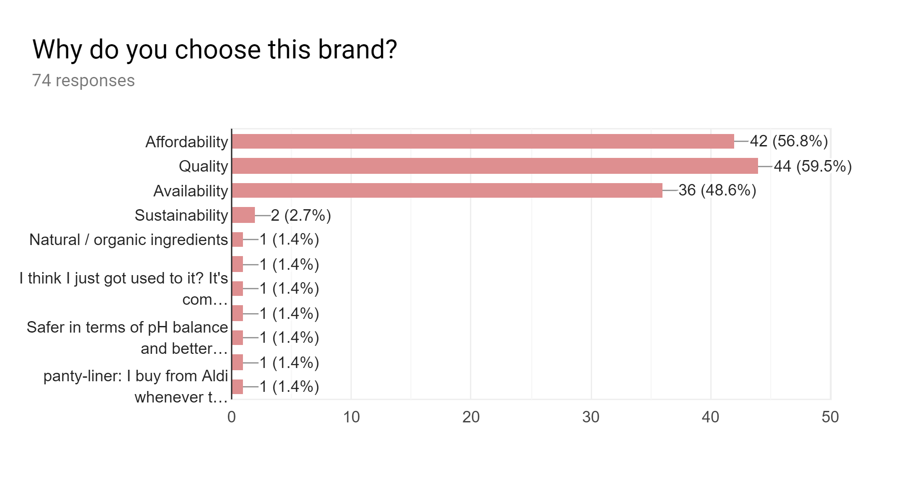

Affordability over Availability?
Notes:
yash

Slide 8

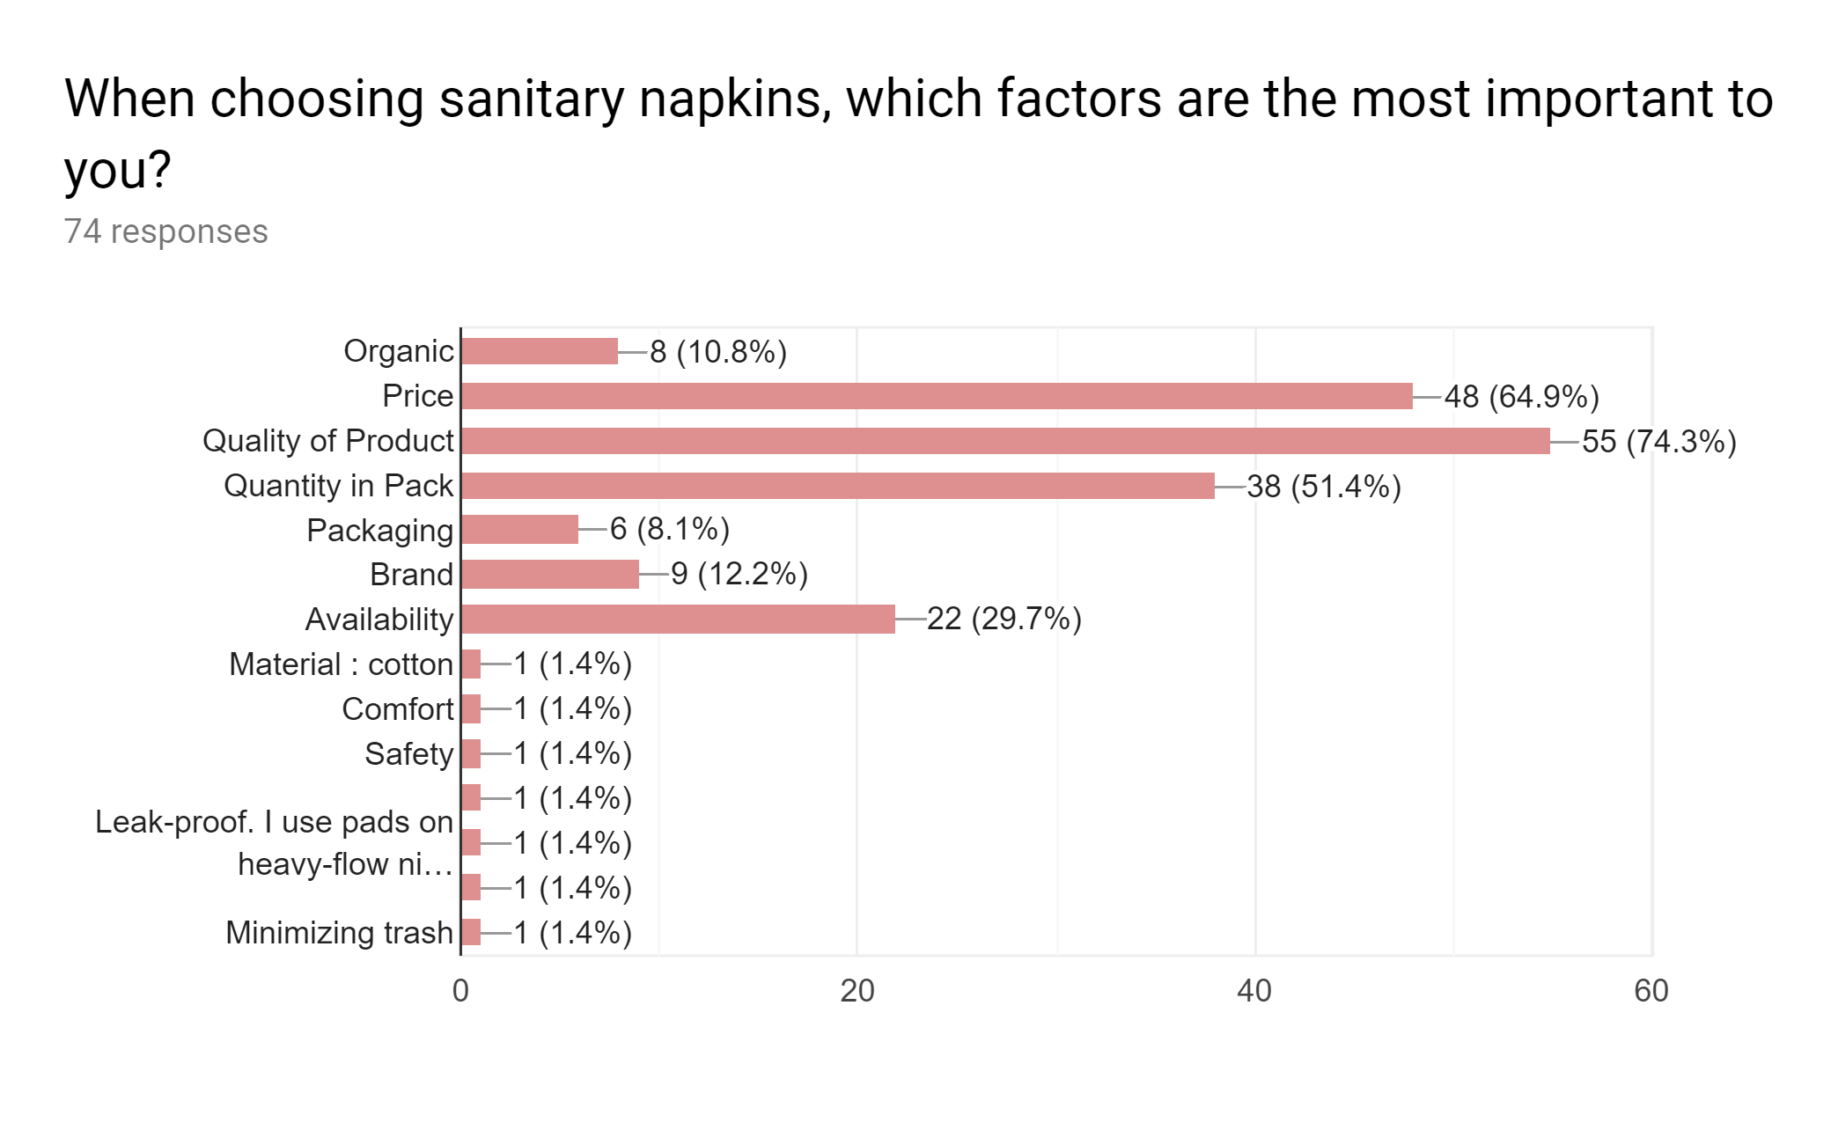
Size Matters
Notes:
yash

Slide 9
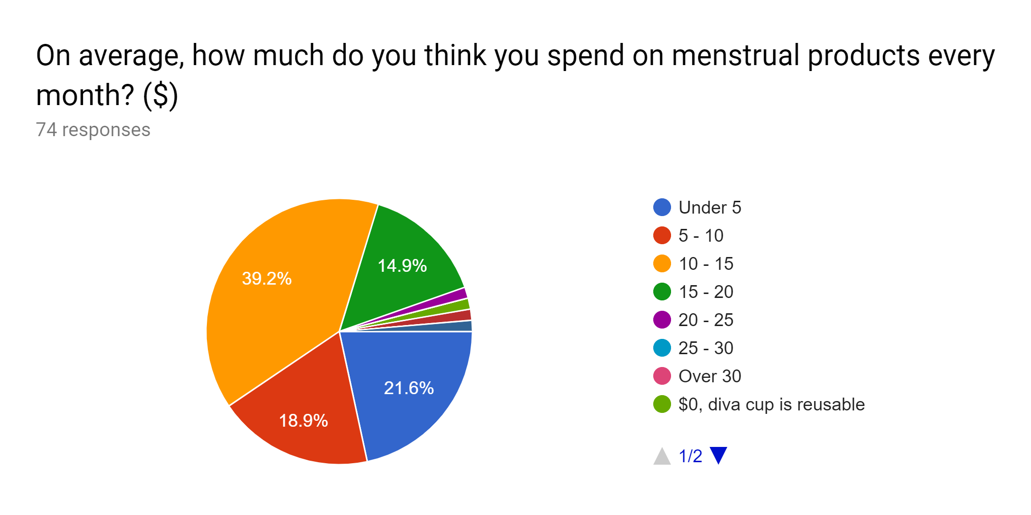

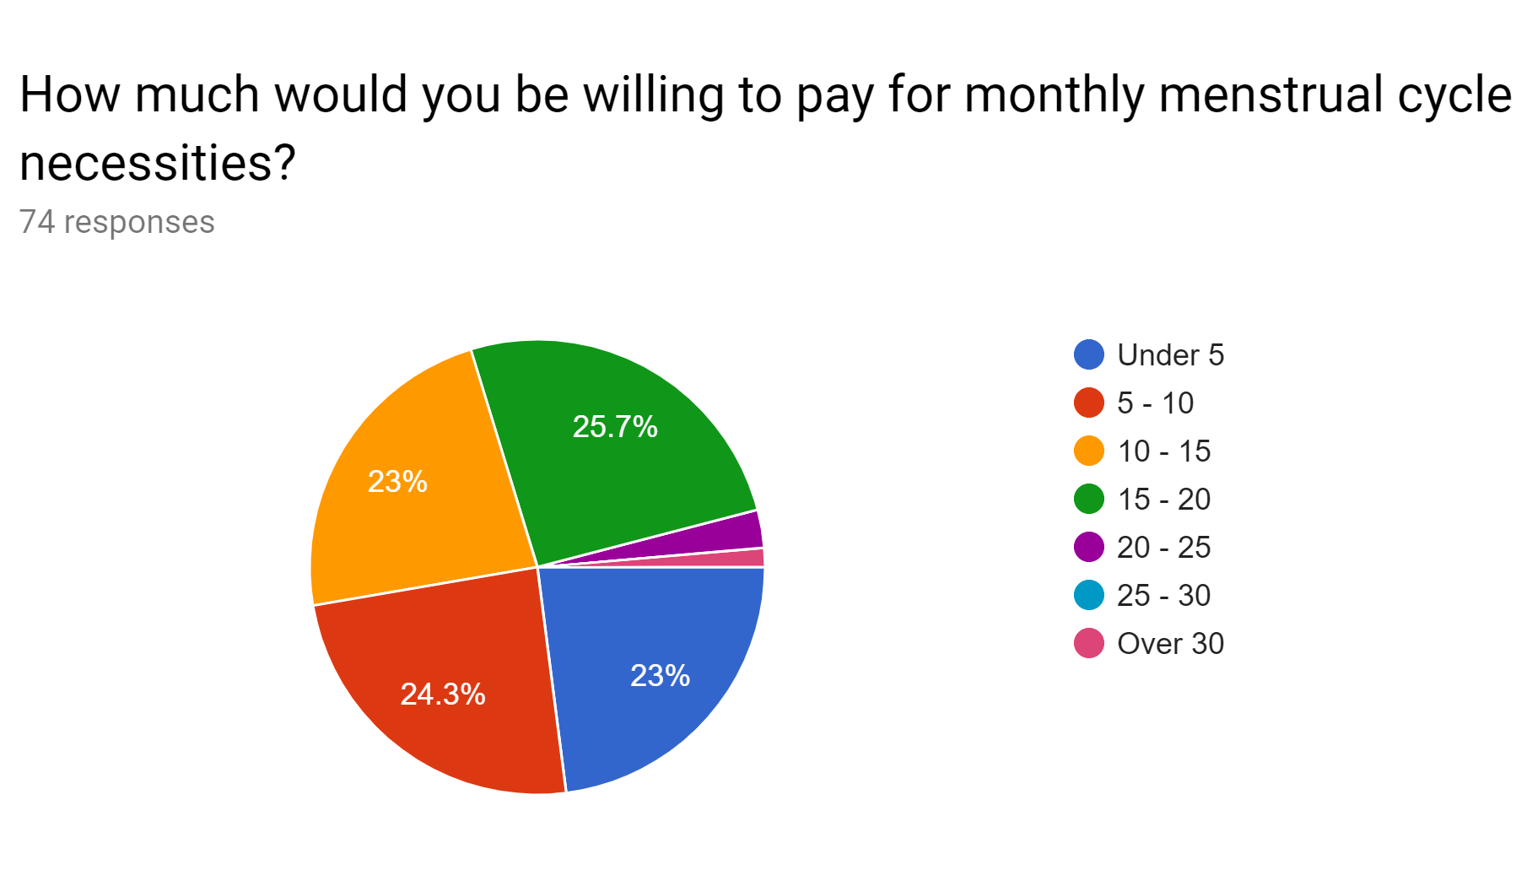
How much does a period cost?
Notes:
yash

Slide 10
Math time.
Notes:
yash

Slide 11
12 x 15 x 40
Notes:
Yash
7200

Slide 12
$7200
Notes:
Yash
7200

Slide 13

We asked how women for other concerns or suggestions about their periods.

Slide 14
This is what they said.
Notes:
yash

Slide 15
“Menstrual products should be free in all public bathrooms. They should not be taxed as luxury items either.”
Notes:
kavya

Slide 16
“I don't think public spaces should charge for sanitary napkins and pads. In my mind, they're like toilet paper.”
Notes:
kavya

Slide 17
“If only there was less stigma around having to take a pad out of your bag and take it to the restroom (for e.g. at work).”
Notes:
yash

Slide 18
“Acknowledgement/studies on the economic impact of periods (on women, on society, on lost earning capacity, economic impact, etc...) that result in substantive reform of our healthcare and employment policies to level playing field and improve economic outcomes. Also, actually fill the damn dispensers in bathrooms.”
Notes:
cathy

Slide 19



KEY INSIGHTS
Dang it! It’s money again!
Wait, I can’t get my quarter out!
Break the Stigma. Period.
01
Price plays an important factor, not only in choosing a brand, but also while choosing the type of sanitary napkin.
03
02
Availability is still a concern. Multiple women suggested to have menstrual products actually available and stocked in public bathrooms.
“Less stigma, more availability, FREE EVEN? No pink tax” - as quoted by our generous survey respondent.
Notes:
Kavya - 1
Yash - 2
Cathy - 3

Slide 20

For now, our target audience is all menstruating women.
Notes:
Cathy

Slide 21

Notes:
Kavya
Whats next? Thats why we’re here to figure it out, but if you guys have any ideas, feel free to let us know about it!

Slide 22


